Slide 1
DATA STRUCTURES WITH C LADDER RIDE!
SAHIL D JAIN
SIDDHANTH SUBBAIAH

Slide 2
THE PROBLEM
Harit wants to climb ladder having n steps but he want to climb only in step of 2 and 5. Now he felt boring repeating same thing again and again. So he discovered new way, now each time Harit wants to climb in step of k also. In other words he can use steps of 2, 5 or k to climb the ladder. So Harit want to calculate number of different ways to reach at cur step, where k and cur are integers. Although Harit is intelligent yet lazy so he wants your help to calculate number of ways. As number of ways could be too large so he wants you to output it modulo 1000000007 (10^9 + 7).

Slide 3
EXPLAINATION
The program developed for the given situation uses mainly the concept of arrays and its associated operations. We have used two arrays to store the number of ways Harit can reach each step starting from step 1. The first array stores the number of ways Harit can reach his desired step in steps of 2’s and 5’s. The second array stores the number of ways Harit can climb the ladder in steps of 2’s, 5’s and k’s, where he decides the value of k.
This program in general is a basic permutation and combination problem where we find the various ways in which Harit can reach his desired step.

Slide 4
First of all we calculate f[i] using only 2 and 5 steps and we can obtain f[i] where f[i] is number of ways to reach at kth step.
f[0]=0; f[1]=0; f[2]=1; f[3]=0; f[4]=1; f[5] = 1 ;
The above values are obtained by simple permutations and combinations as the value of the current step is less.

Slide 5
For simple query, where cur < k or k == 5 as step of k will not affect result, answer can be calculated using recurrence relation
f[ i ] = ( f[i-2] + f[i-5]) %mod // where 6 <= i <= n
The above recurrence relation can be calculated once and in further such test cases answer will be f[cur] .
For cur>=k, we can do ,f[k]=(f[k]+1)%mod; f[ i ] = ( f[ i-2 ] + f[ i-5 ] + f[ i-k ] ) %mod ;
where k+1 <= i <= cur . as sum of cur is less than or equal to 10^7 over all test cases , hence easily acceptable.

Slide 6
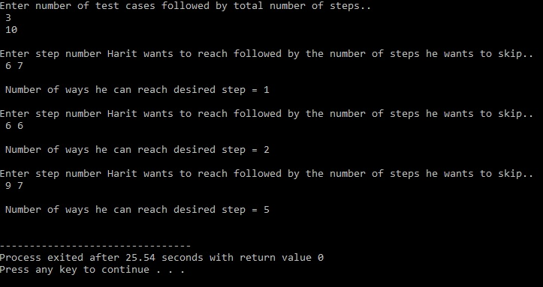

Slide 7


